Slide 1
Group Project I
The Charlotteans 1/20/2019
Team Members:
Matt Clewis
Teya Robinson
Zacharias Girmay
Christopher Sloat
Clint Jansson

Slide 2
TEAM Hypothesis
We wish to prove that cost of living, population and homelessness have a positive correlation to each other.
We plan to see an increase in Charlotte’s
Population
Housing prices
Cost of living
Homeless population

Slide 3
Definitions:
Homelessness: An individual who lacks housing including those in transitional quarters, public or private shelters, and temporary housing.
Poverty: Amount of families living below the US Census calculated poverty threshold. Poverty threshold is calculated salary total specific households much reach to not be considered in poverty.
Cost of Living index: A indicator that measures the change in the cost of a fixed basket of products and services—e.g. housing, food, utilities. Cities are compared to a national average and salary differences by area taken into account.

Slide 4
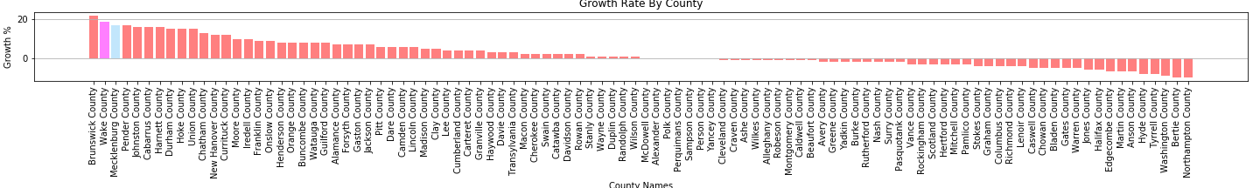
Migration : population growth
Mecklenburg County is number 1 in total population
Mecklenburg County is number 2 in Numeric Change
Mecklenburg County is number 3 in Growth Rate
Mecklenburg County’s Growth Rate is 17%
Notes:
This data was obtained from UNC Chapel Hill and shows the growth rate of all counties in North Carolina as well as total population and numeric change ranking. This data shows that Mecklenburg county is growing at a far higher rate than most other counties and has the most people in general. The only county to outrank Mecklenburg in total population added is Wake County. Brunswick county is number 1 in growth rate but they are a small county of 10,000 meaning their addition of 2,000 people over ten years is makes their growth rate a bit misleading when compared to the 100,000 added to Wake and Mecklenburg county.

Slide 5
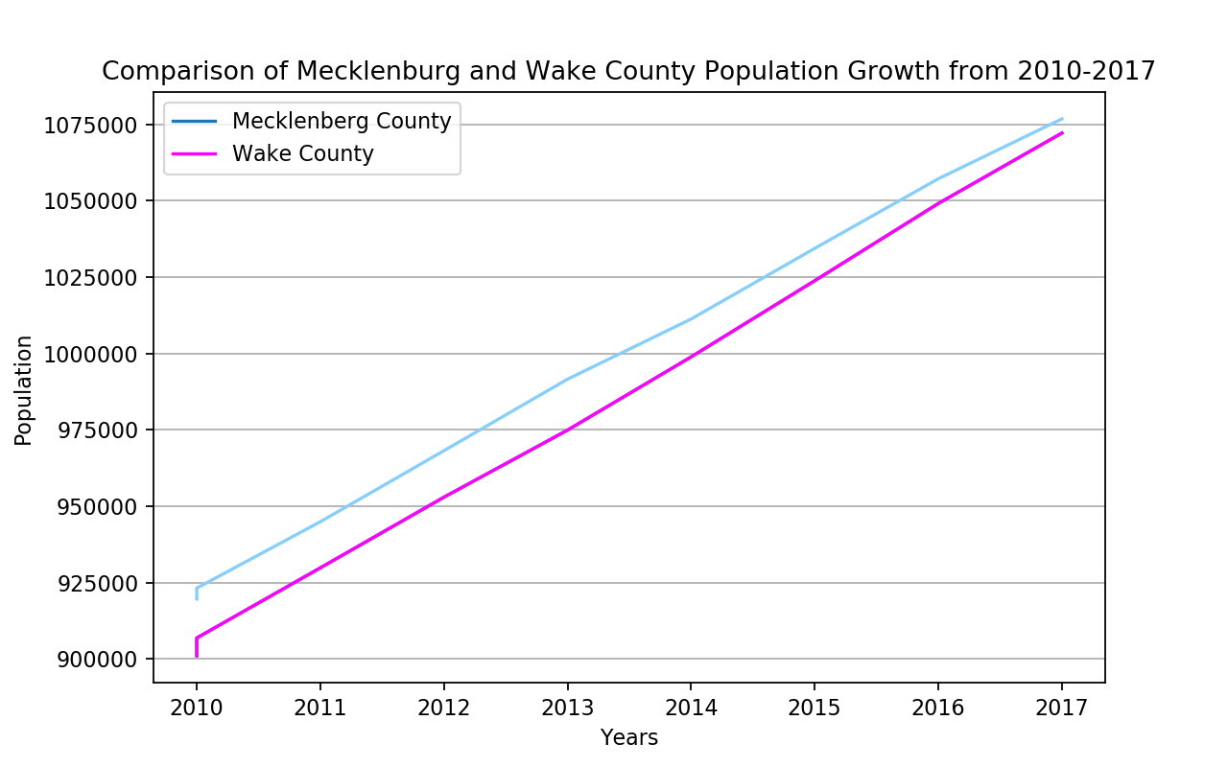
Population CHange

Slide 6
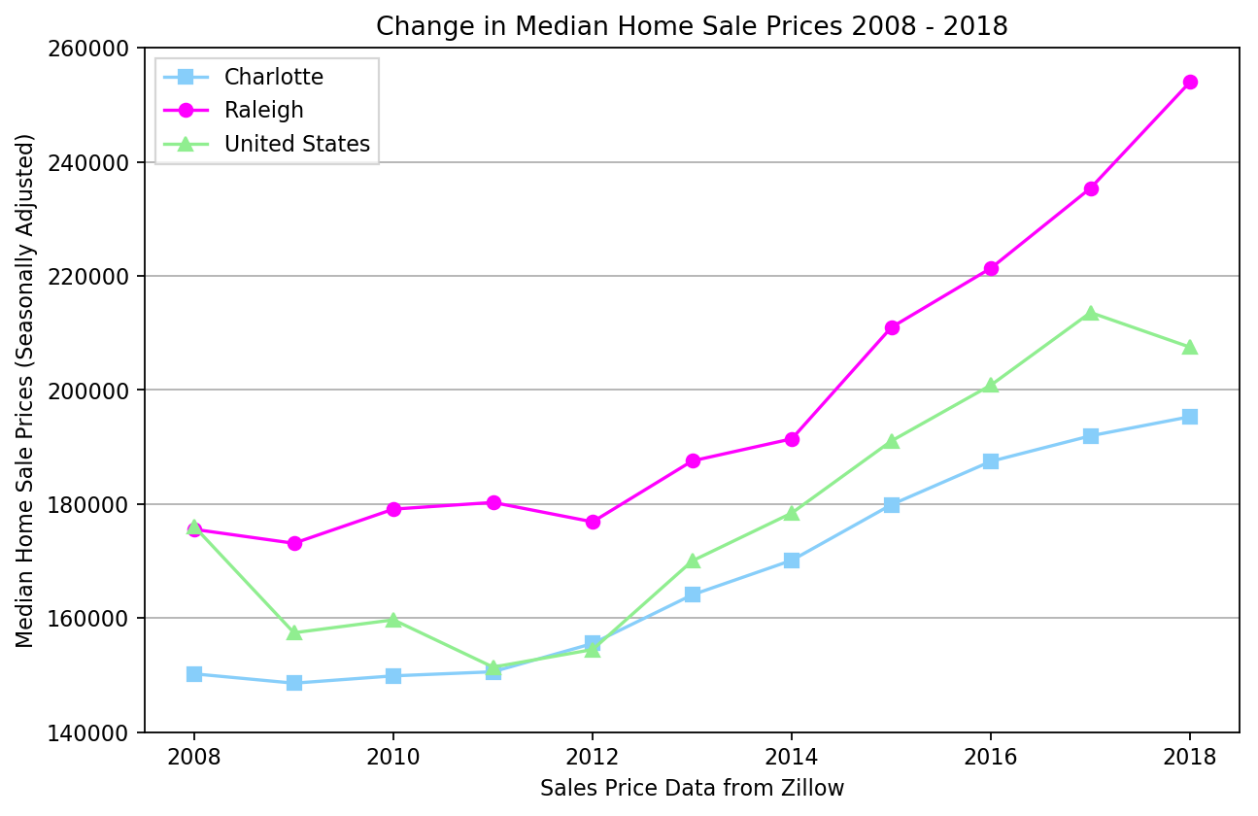
Livelihood : Housing prices

Slide 7
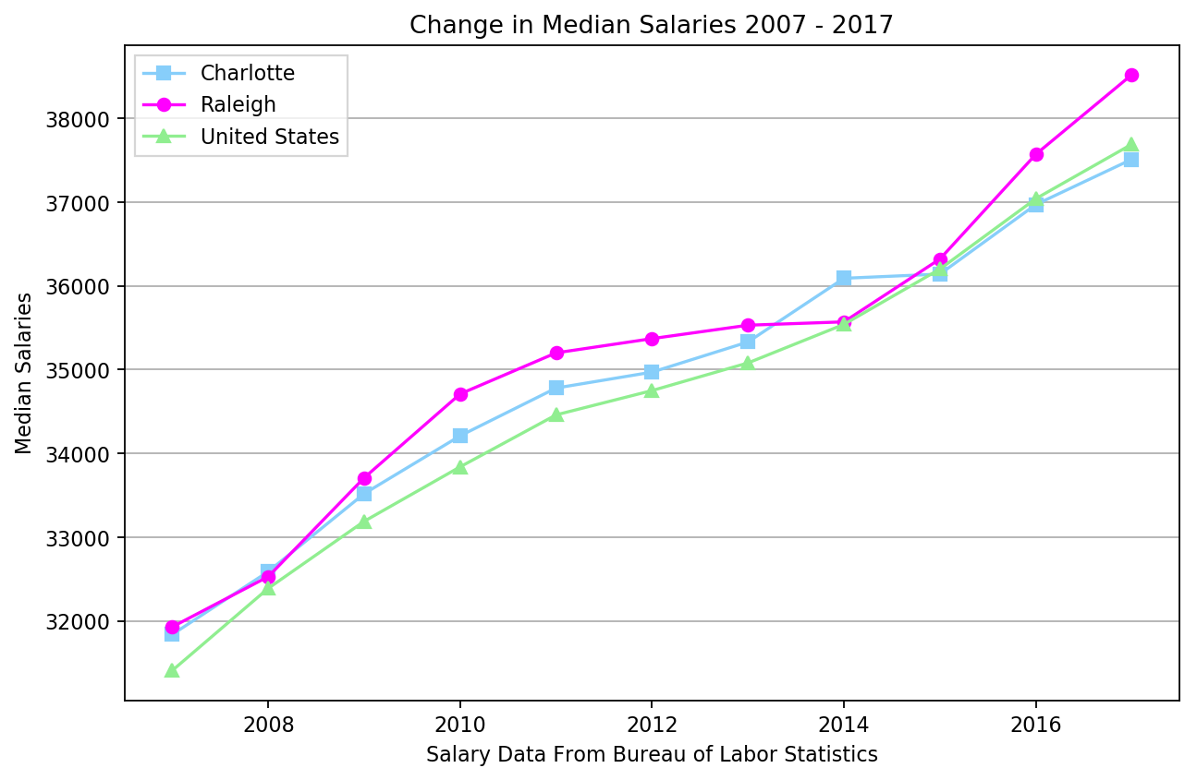
Economy : salary

Slide 8
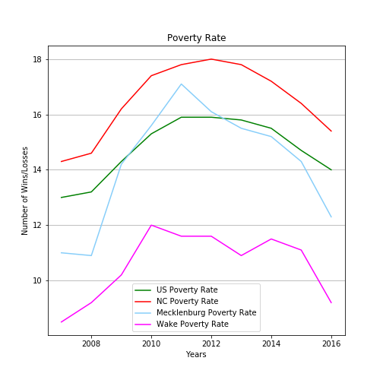
Economy : Poverty

Slide 9
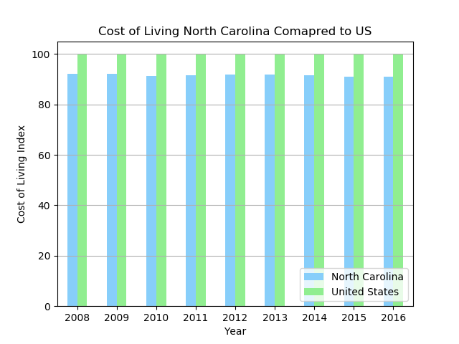
Economy : cost of living

Slide 10
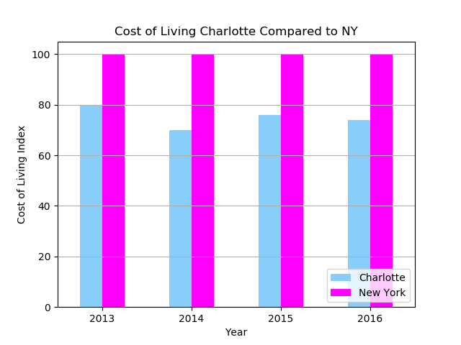
ECONOMY: COST OF LIVING

Slide 11
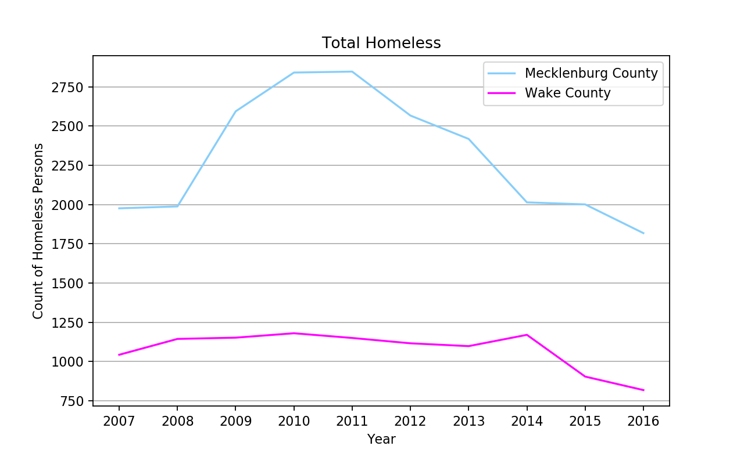
Community : Homelessness

Slide 12
Conclusions
2 out of 4 of the expected results of the hypothesis were not supported.
The Population increase -- Supported
Cost of living -- Unsupported
Housing prices -- Supported
Homelessness -- Unsupported
2010 the homeless population of Mecklenburg began deceasing.
2009 President Obama’s Open Door policy was deployed. Correlates to the drop in homelessness.
The recent growth rate of Charlotte has increased along with the standard of living despite the concerns for affordable housing.
Data mining for this was impeded by 2 things:
Limited sources of free data for housing and salary information
Many government websites were closed/unavailable due to the shutdown

Slide 13
Appendix : data sources
Homeless CSV data source :
Hud Exchange(2018). PIT and HIC Data Since 2007. Retrieved from https://www.hudexchange.info/resource/3031/pit-and-hic-data-since-2007/
Population Estimates , Change, Poverty, Growth Rate:
UNC (2018). Carolina Demography. Retrieved from
https://demography.cpc.unc.edu/resources/data-tables/
Salary Data:
Bureau of Labor Statistics. Occupational Employment Statistics. Retrieved from
https://www.bls.gov/oes/tables.htm
Housing Prices:
Zillow (2019). Research Data. Retrieved from
https://www.zillow.com/research/data/
Cost of living:
Open Data Network(2019). Cost of living index. Retrieved from
https://www.opendatanetwork.com/entity/0400000US37/North_Carolina/economy.cost_of_living.index?component=all&year=2016
Homeless programs in Charlotte:
Mecklenburg County. February 2015 Supportive Housing RFP​. Retrieved from
https://www.mecknc.gov/CommunitySupportServices/HomelessServices/Housing-Stability-Funding/Pages/February-2015-Supportive-Housing-RFP.aspx

